Slide 1

Powered Resume Builder
Project Title:
Presented By:
Presented To:
Powered Resume Builder
Darshansinh Devda
Pranaykumar Chauhan
Burhanuddin Savliwala
Amal Gupta
Chadi Abboud
Prof. Joumana Dargham

Slide 2


Problem
Job seekers struggle to create resumes tailored to specific roles.
Existing tools lack AI-driven customization and real-time feedback.
Generic resumes fail ATS (Applicant Tracking Systems) filtering.

Slide 3

Build an AI-powered platform for personalized resume creation.
Optimize resumes for ATS and specific job descriptions.
Provide real-time feedback and actionable insights.
Cross-platform accessibility (web and mobile).
Enable user-friendly customization of templates.
Objective

Slide 4

Objective
AI-driven platform for creating ATS-optimized, personalized resumes tailored to job descriptions.
Financial Feasibility
Initial Costs: ~$130,000 for design, development, AI, cloud setup, and testing.
Operational Costs: ~$70,000 annually for hosting, AI computing, and marketing.
Revenue: Subscription, freemium model, and affiliate marketing.
Break-even: Targeted in the first year with 5,000 premium users.
Legal Feasibility
Data Compliance: Adherence to GDPR and CCPA for privacy.
Intellectual Property: Proprietary AI and code with legal protections.
Terms of Service: Clear policies on data usage and user rights.
Technical Feasibility
Operational Feasibility
Team: Requires frontend, backend, AI/ML engineers, UI/UX designers, and QA.
Methodology: Agile approach with tools like Jira and Trello.
Support: Customer service, FAQs, and training materials.
Platform: Web and mobile (iOS, Android) using React and React Native.
AI Model: Resume optimization based on job descriptions using machine learning and NLP.
Backend: Cloud-based with PostgreSQL and MongoDB; powered by Node.js and Express.
Security: End-to-end encryption and strict data privacy measures.

Slide 5





AI-driven personalization and dynamic content suggestions.
Analytics dashboard for tracking performance.
Real-time ATS feedback and optimization.
Key Features
Multilingual support and cross-platform accessibility.
Collaborative peer-review functionality.
Visuals: Feature icons or process flowchart.

Slide 6
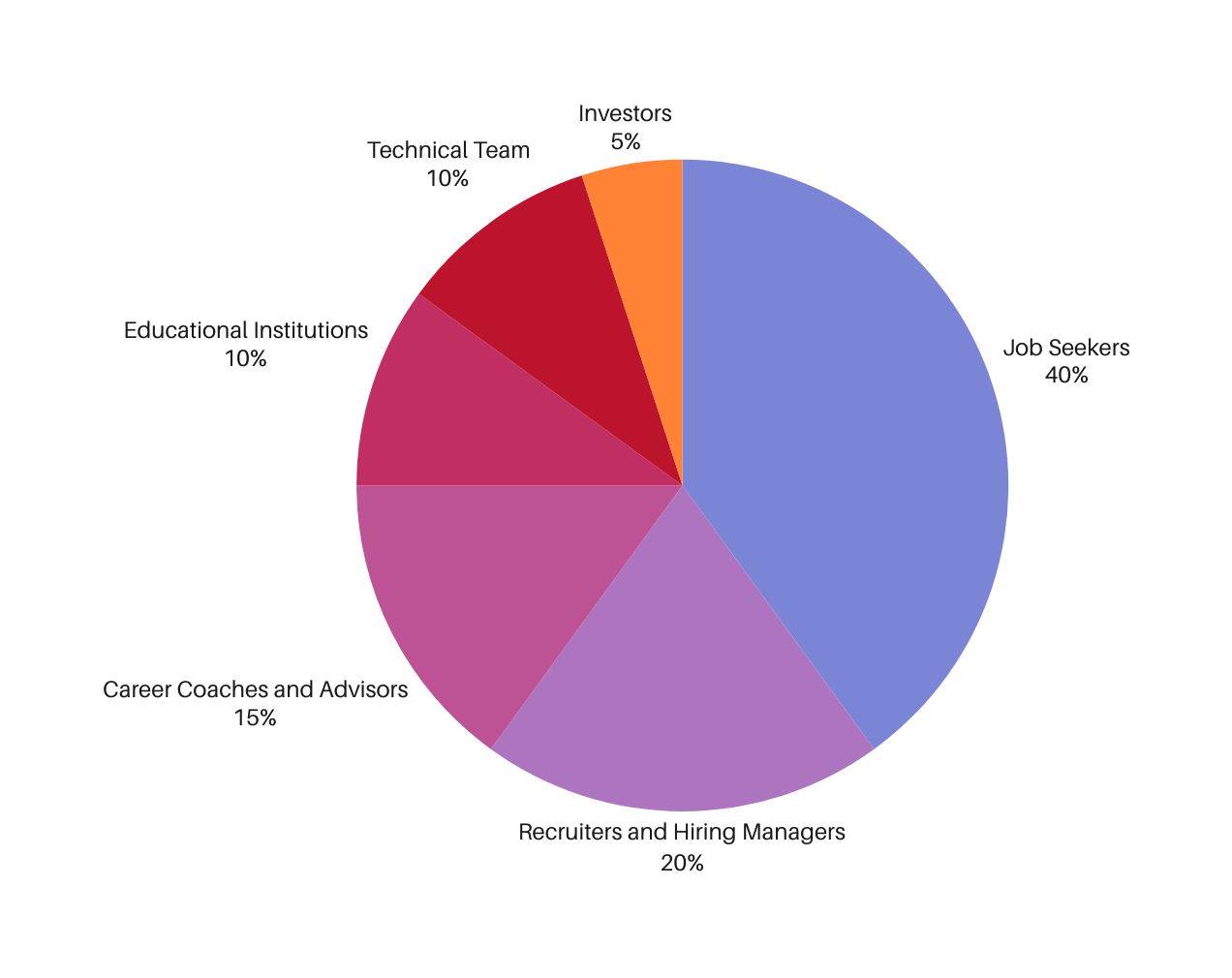
Stakeholders
Job Seekers: Primary users; need tailored, ATS-optimized resumes with real-time feedback.
Recruiters & Hiring Managers: Indirect beneficiaries; receive well-structured, relevant applications.
Career Coaches & Advisors: Recommend the platform; need effective tools for client success.
Educational Institutions: Integrate into career services; support students’ job readiness.
Technical Team: Build and maintain the platform; ensure feature reliability and scalability.
Investors: Provide funding; require clear plans and profitability updates.

Slide 7
Project Timeline
Phases | Month 1 | Month 2 | Month 3 | Month 4 | Month 5
Project Initiation & Planning
Market Analysis
Product Design
Core Feature Development
Additional Features
Testing & Quality Assurance
Project Final Release

Slide 8

Resource Allocation and Dependencies
Human Resources
Project Manager: Oversees project, manages timelines, and coordinates teams.
UI/UX Designer: Interface and experience design (Weeks 4-5).
AI Engineer: AI-powered personalization & feedback (Weeks 6-7).
Backend Developer: Database and analytics dashboard (Weeks 6-9).
Frontend Developer: User interface & multi-platform support (Weeks 4-9).
QA Engineer: UAT, bug fixes, optimizations (Weeks 10-12).
Technical Writer: Documentation & training resources (Week 13).
Technological Resources
AI Tools: Personalization (Weeks 6-7).
UI/UX Tools: Figma/Adobe XD (Weeks 4-5).
Database & Server: Storage & analytics (Weeks 6-9).
Testing Tools: QA & bug tracking (Weeks 10-12).
Critical Dependencies
Market Insights → UI/UX Design.
Core Development → Testing Phase.
Documentation → Product Launch.

Slide 9
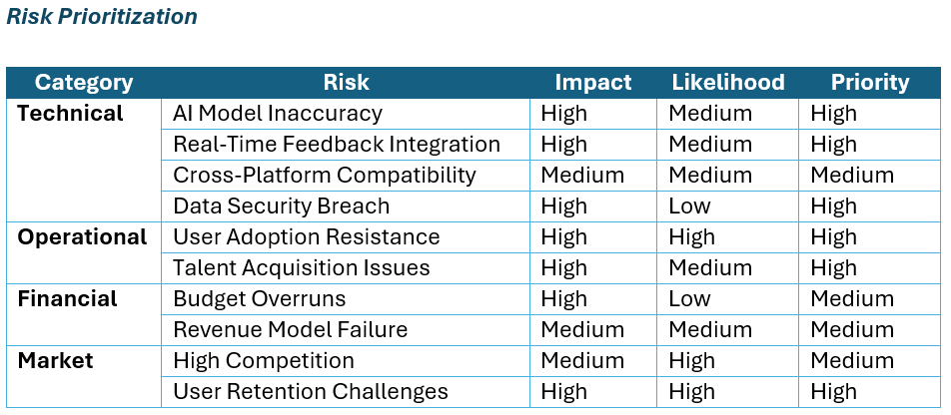
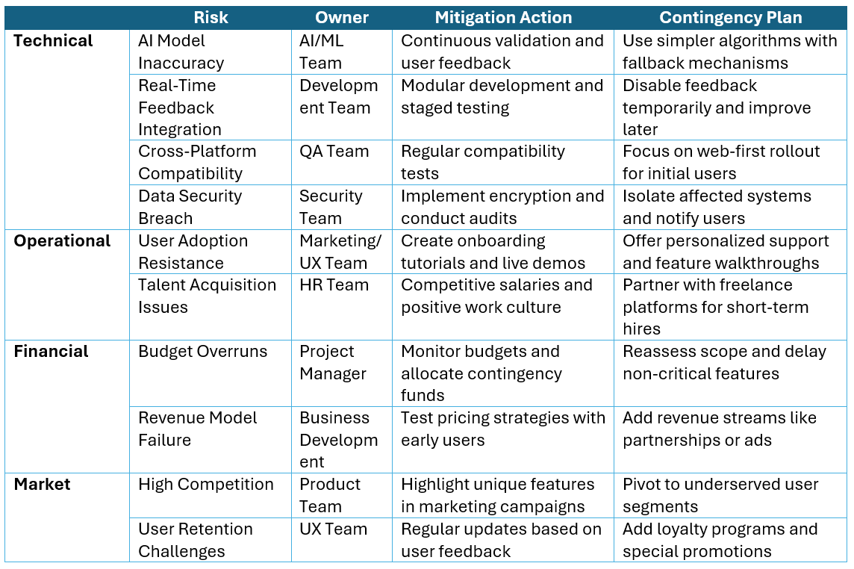
Risk Assessment and planning
In risk assessment and planning, it is crucial to focus on identifying potential technical, operational, financial, and market risks while prioritizing them based on their likelihood and impact.
For technical risks, such as AI accuracy and system downtime, implementing continuous validation and robust infrastructure is key.
Operational risks, including user adoption challenges and talent acquisition, require strategies like user education and competitive recruitment practices.
Financial risks, such as budget overruns and revenue failure, should be mitigated through staged funding and flexible pricing models.
Lastly, addressing market risks like competition and user retention demands innovation, user feedback integration, and loyalty programs to ensure sustained engagement and growth

Slide 10
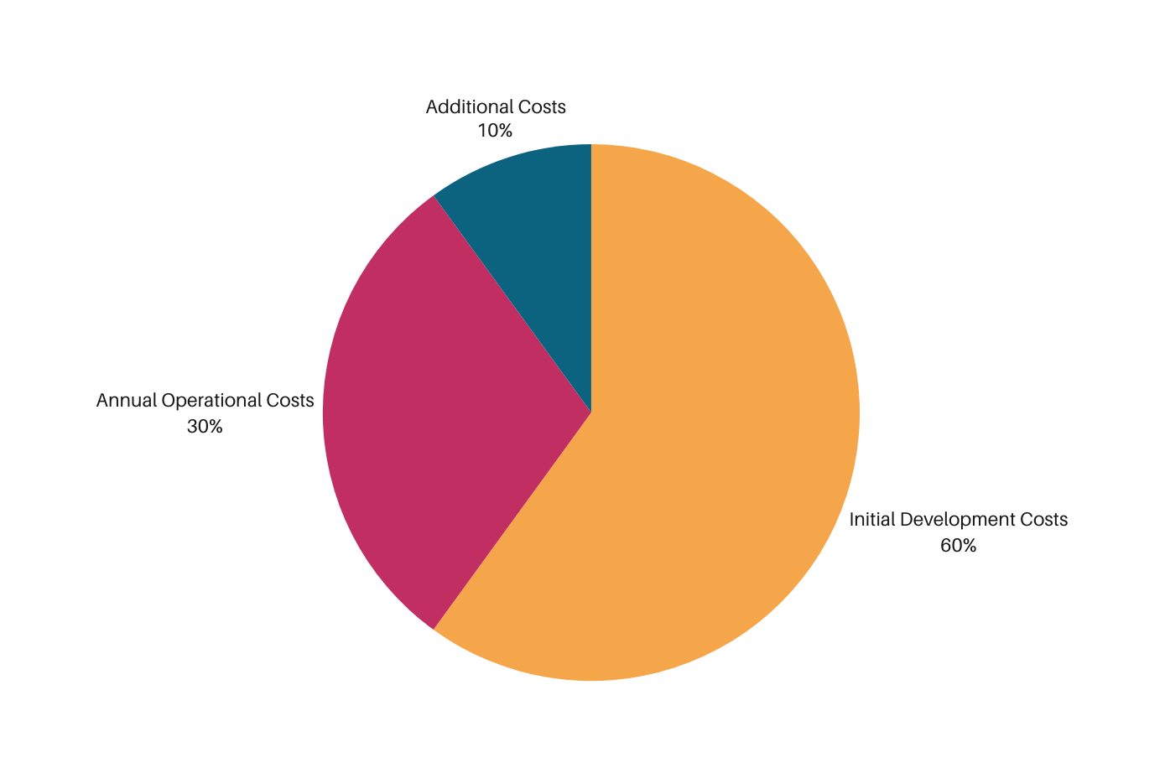
Budget
Initial Development Costs: The majority of the budget is allocated to designing, developing, and testing the platform.
Annual Operational Costs: Covers hosting, database management, AI computing, security, and customer support.
Additional Costs: Accounts for training programs, feedback iterations, and market expansion.

Slide 11
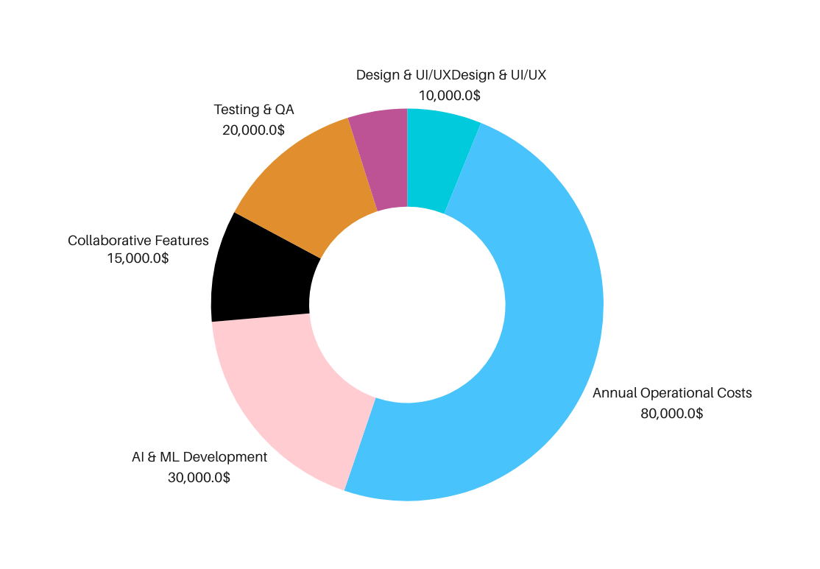
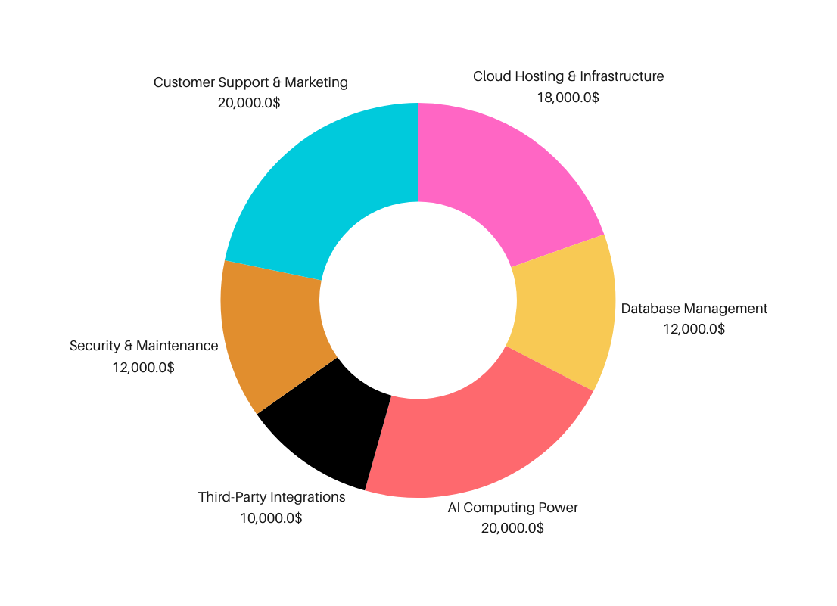
Initial Development Costs Breakdown
Annual Operational Costs
Breakdown

Slide 12
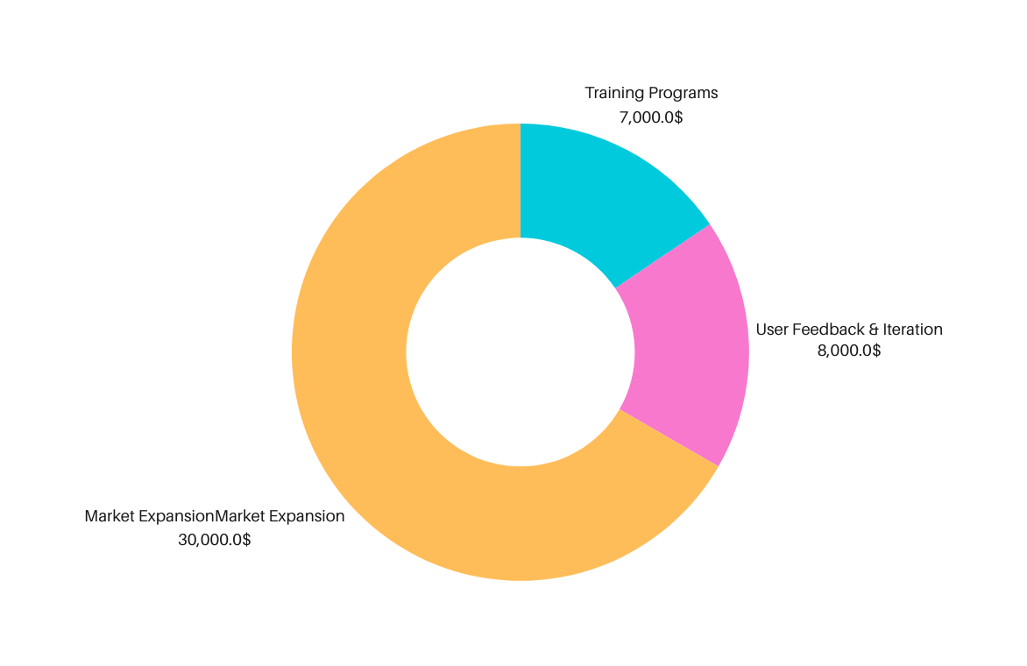
Budget
Budget
Additional Costs
Breakdown
Total Cost BreakDown
Initial Development Costs: $120,000 - $173,000
Covers design, development, testing, and research.
Annual Operational Costs: $67,000 - $94,000
Includes hosting, AI computing, maintenance, and customer support.
Additional Costs (Optional): $30,000 - $45,000
Focuses on training, feedback, and market expansion.
Grand Total (First Year): $212,000 - $275,000

Slide 13




THANK YOU

